Slide 1
UNIT-II
Regular Languages
Context Free Grammars

Slide 2
Contents
Regular Languages, Regular sets, regular expressions, constructing finite Automata for a given regular expression, Conversion of Finite Automata to Regular expressions. Closure properties of regular sets (proofs not required).
Context Free Grammars: Context free grammar, derivation trees, right most and leftmost derivation, ambiguity in context free grammars, simplification of Context Free Grammars (removal of Ɛ-productions, UNIT productions and useless symbols). Chomsky normal form(CNF),Greibach normal form (GNF).

Slide 3
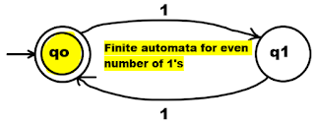
Regular Set
A special set of words over input alphabet Σ is called regular set.
Any set that represent the value of a Regular expression is called regular set.
Regular sets are set which are accepted by FA (finite automata). For example: L = {ε, 11, 1111, 111111, 11111111…}
Here L is language set of even number of 1’s. Finite automata for above language L is,
The give set L is regular set because we can represent it using finite automata.

Slide 4
Regular Expressions
It is a method to represent a language.
It is a set of characters that represent search pattern for any string.
A language is regular if it can be expressed in terms of regular expression.
Regular Expressions are used to denote regular languages. An expression is regular if:
If ɸ is a regular expression for regular language ɸ.
If ɛ is a regular expression for regular language {ɛ}.
If x is regular expression and regular language is {x}.
If a and b are regular expression, a + b is also a regular expression with language {a,b}.(i.e A union B)
If a and b are regular expression, ab (concatenation of a and b) is also regular.
If a is regular expression, a* (0 or more times a) is also regular.
A grammar is regular if it has rules of form A -> a or A -> aB or A -> ɛ where ɛ is a special symbol called NULL.

Slide 5
Regular Expressions Examples
The set of all strings containing the substring 00 over ∑={0,1}
(0/1)* 00 (0/1)*
The set of all strings containing at most two 0’s over ∑={0,1}
(0/1)*0(0/1)*0(0/1)*
The set of all strings that begin and end with 1 over ∑={0,1}
1(0/1)*1
The set of all strings that ends with aa over ∑={a,b}
(a/b)*aa
The set of all strings that has at most 2a’s over ∑={a,b}
(b)*+(b)*a(b)* + (b)*a(b)* a(a)*
The set of all strings that has exactly 2a’s over ∑={a,b}
(b)*a(b)* a(b)*
The set of strings over {0,1} that end in 3 consecutive 1's.
(0 | 1)* 111
The set of strings over {0,1} that have at least one 1.
0* 1 (0 | 1)*
The set of strings over {0,1} that have at most one 1.
0* | 0* 1 0*

Slide 6
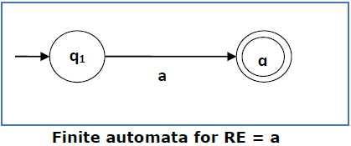
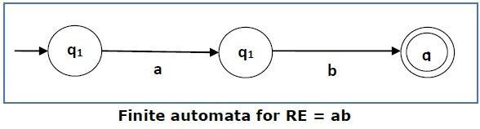
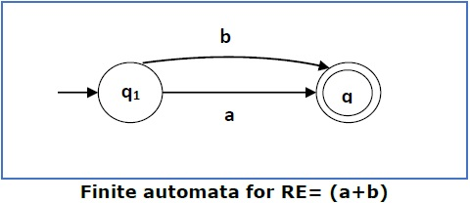
Construction FA for given RE
We can use Thompson's Construction to find out a Finite Automaton from a Regular Expression. We will reduce the regular expression into smallest regular expressions and converting these to NFA and finally to DFA.
It will done with two ways 1) Direct Method 2) Subset Method
Direct Method:-
Some basic RA expressions are the following
For a regular expression ‘a’, we can construct the following FA.
For a regular expression ‘ab’, we can construct the following FA .
For a regular expression (a+b), we can construct the following FA

Slide 7
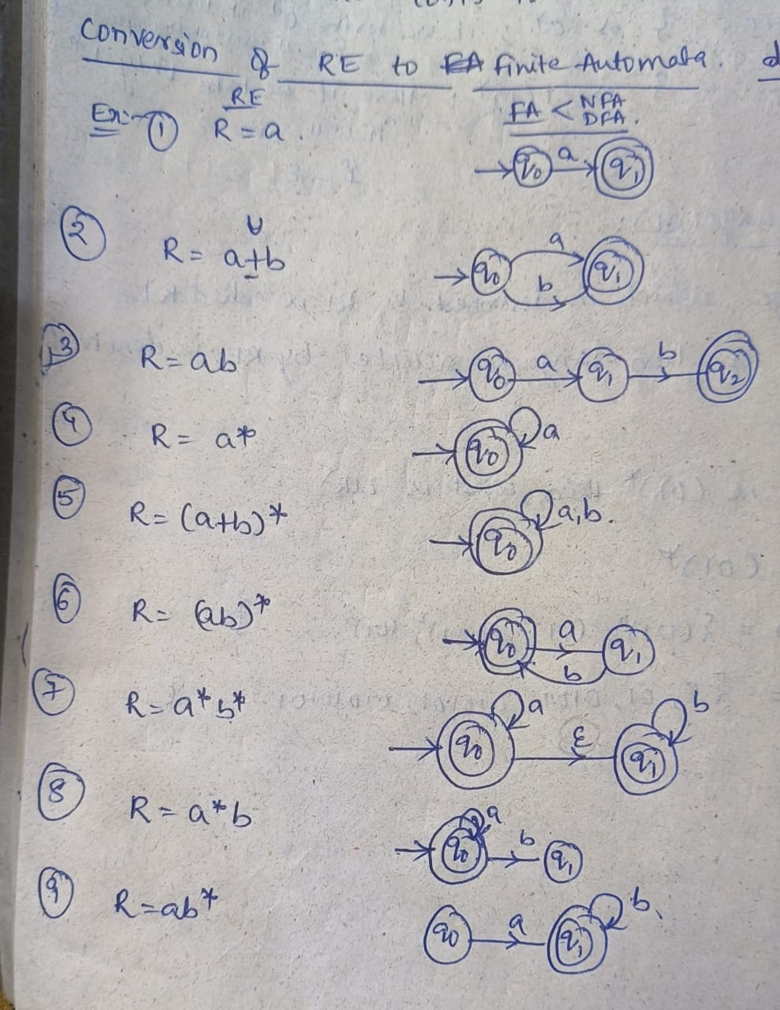
Construction FA for given RE Direct Method

Slide 8
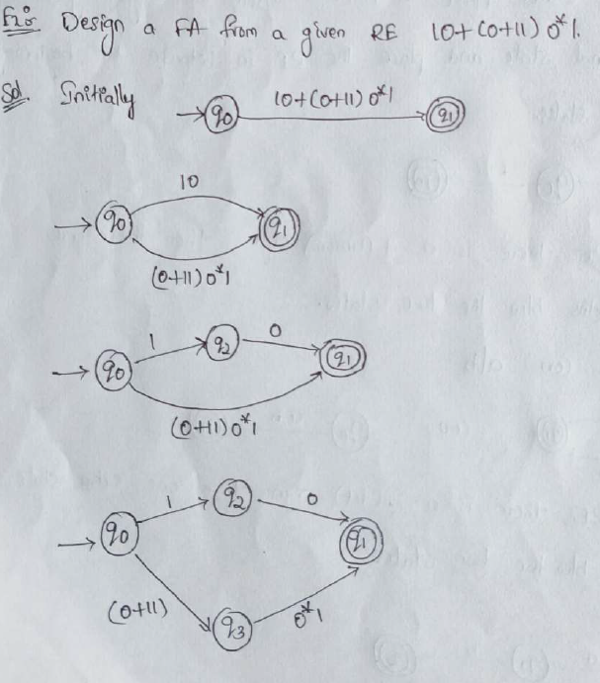
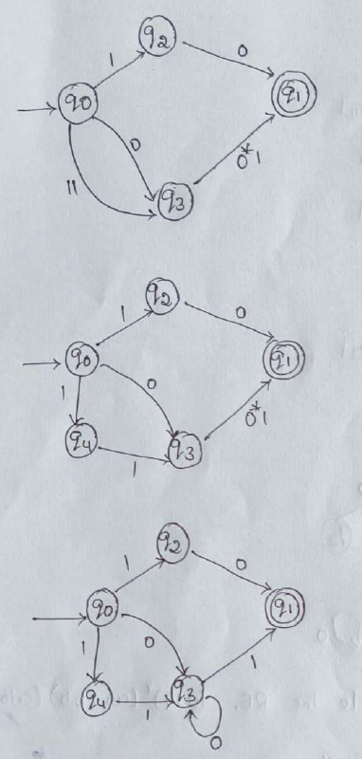
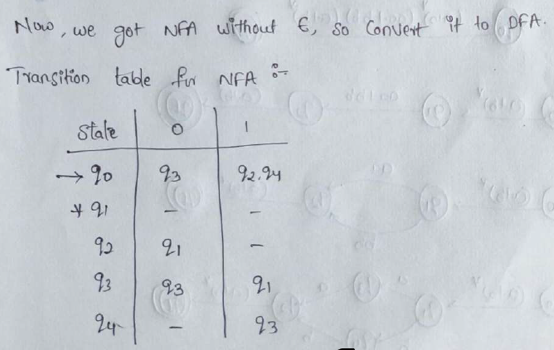
Example
Step-4
Step-1
Step-5
Step-2
Step-6
Step-3

Slide 9
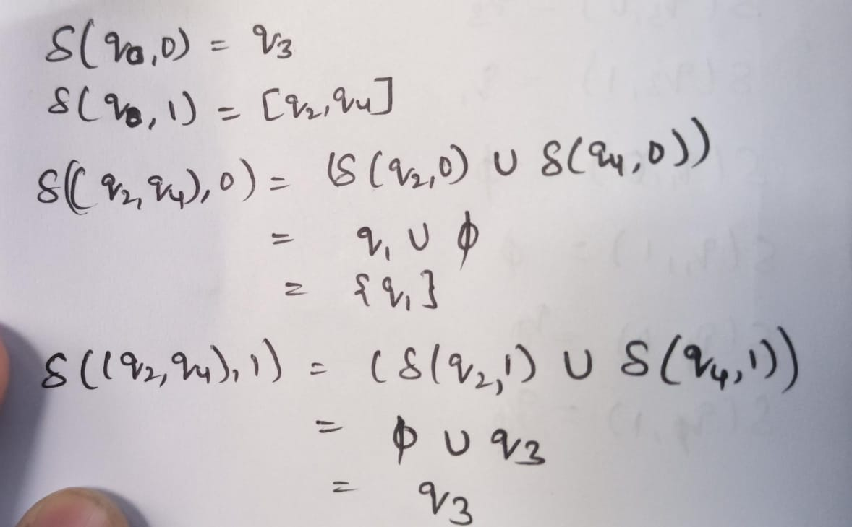
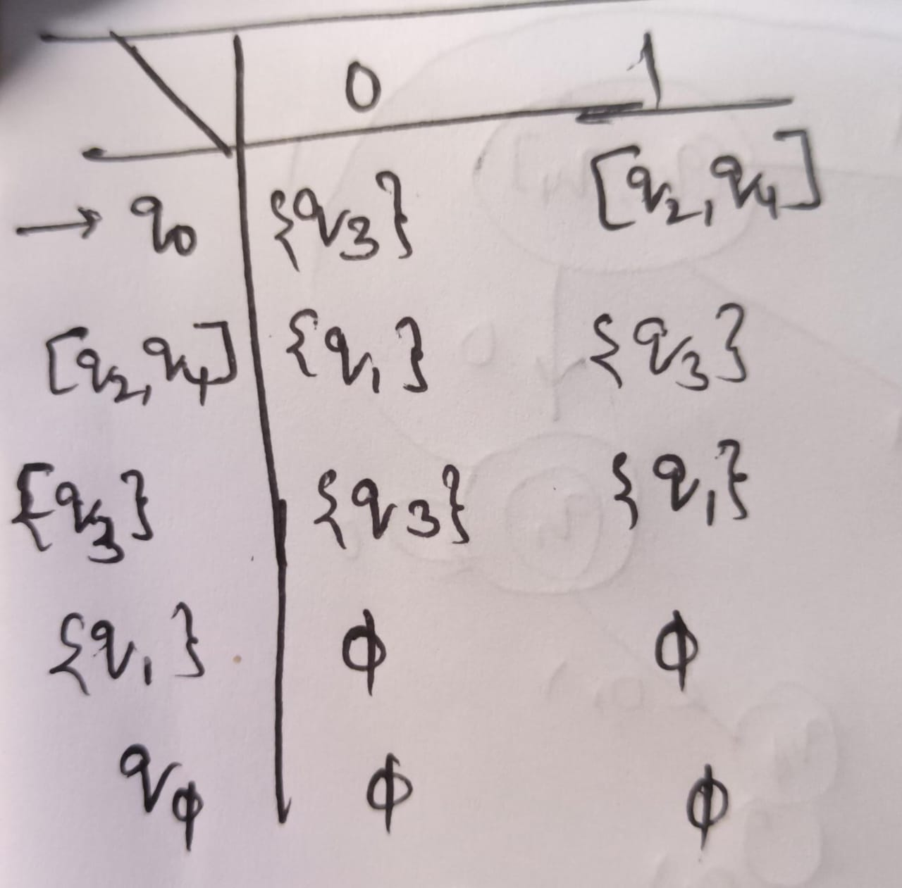
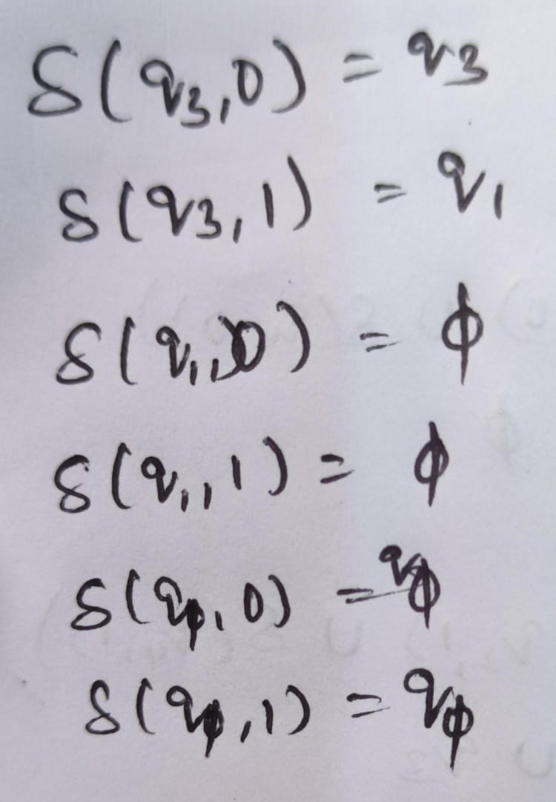
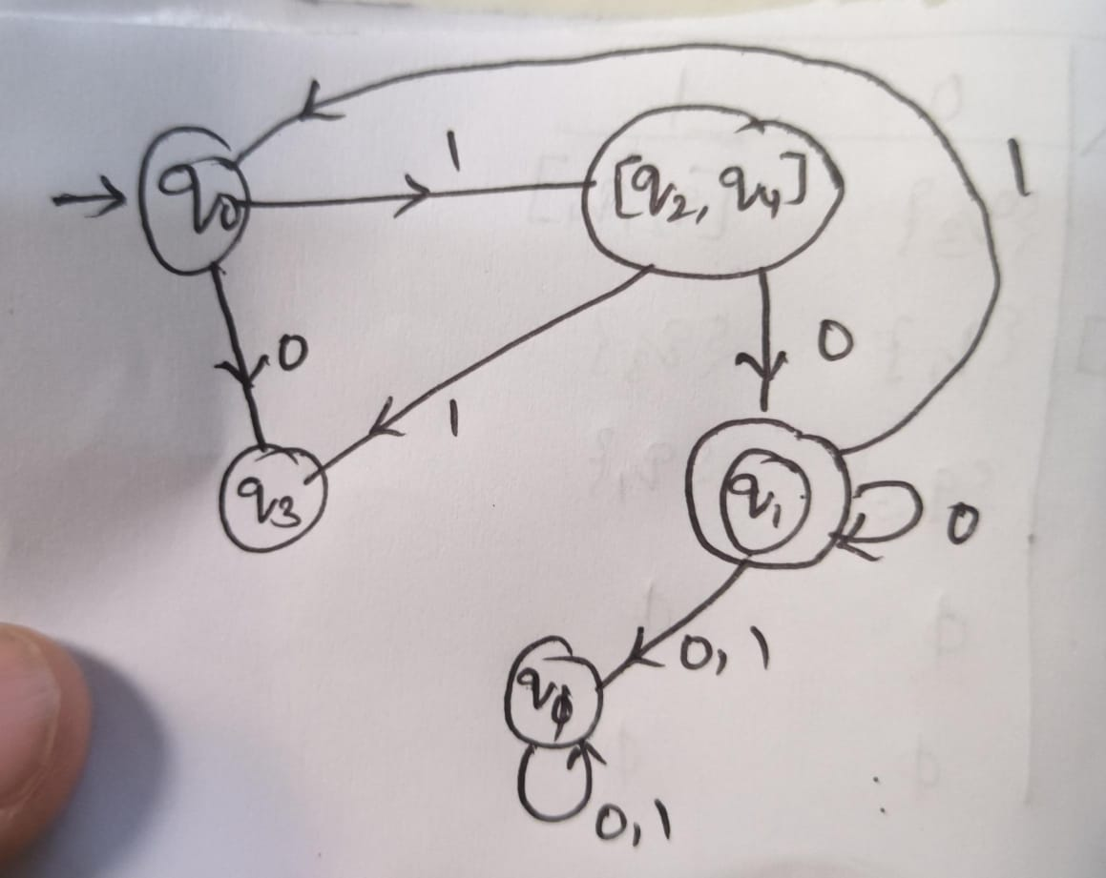
DFA Transition Table
Transitions
DFA

Slide 10
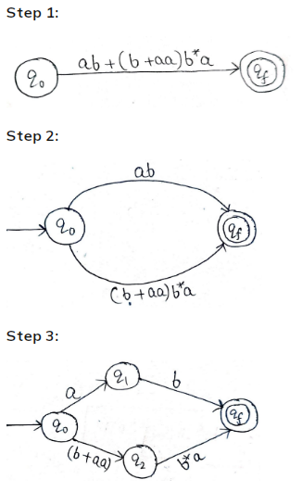
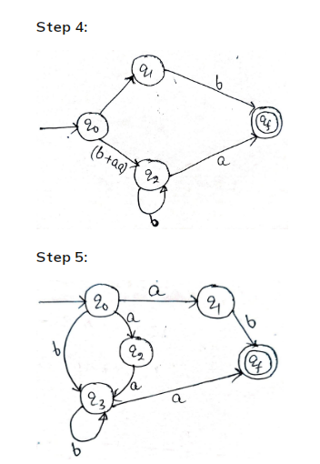
Examples
Ex:1. Design a Finite Automata from the given RE [ ab + (b + aa)b* a ].
Solution. At first, we will design the Transition diagram for the given expression.

Slide 11
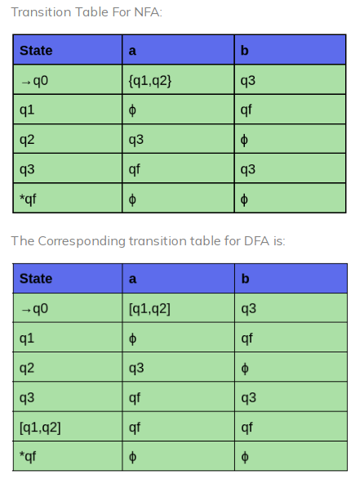
After step 5, we have got NFA without ε. Now we will convert it into the required DFA; we will first write a transition table for this NFA.

Slide 12
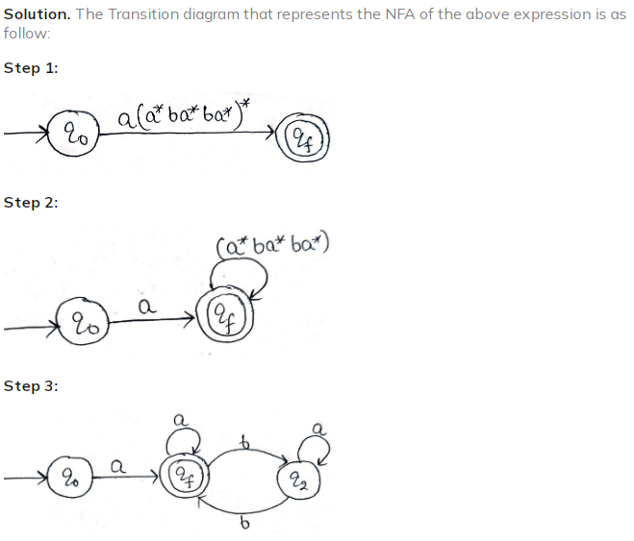
Ex:2. Design an NFA from the given RE [ a (a* ba* ba*)* ].

Slide 13
Identities Related to Regular Expressions
Given R, P, L, Q as regular expressions, the following identities hold
∅* = ε
ε* = ε
RR* = R*R→ R*
R*R* = R*
(R*)* = R*
(PQ)*P =P(QP)*
(a+b)* = (a*b*)* = (a*+b*)* = (a+b*)* = a*(ba*)*
R + ∅ = ∅ + R = R (The identity for union)
R ε = ε R = R (The identity for concatenation)
∅ R = R∅ = ∅ (The annihilator for concatenation)
R + R = R (Idempotent law)
L (M + N) = LM + LN (Left distributive law)
(M + N) L = LM + LN (Right distributive law)
ε + RR* = ε + R*R = R*

Slide 14
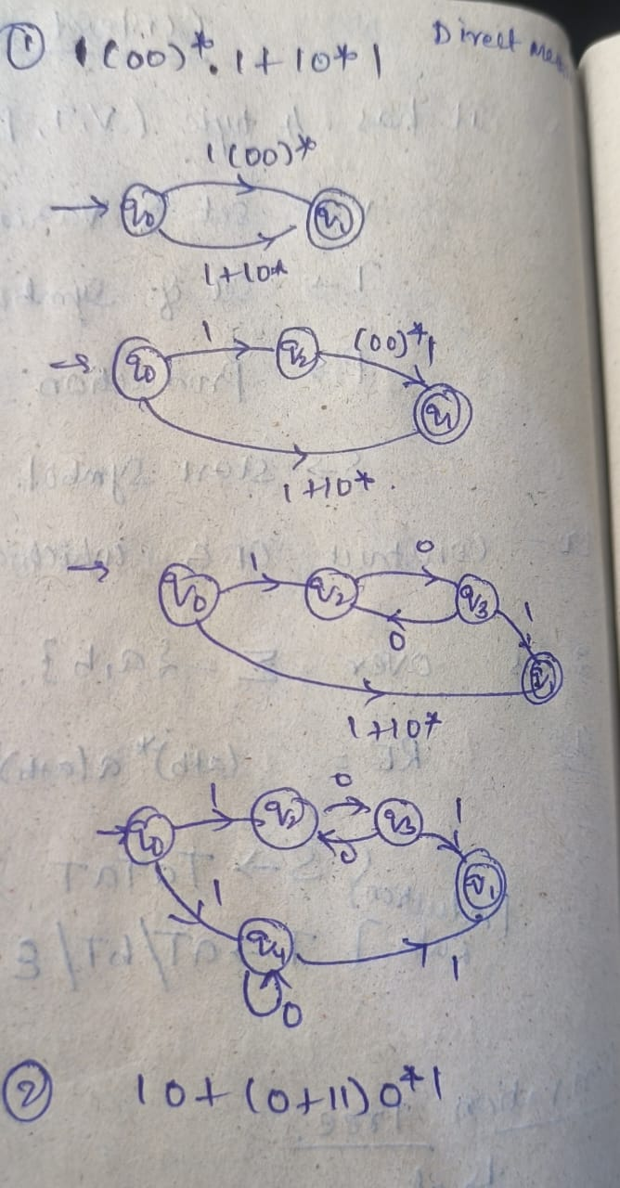
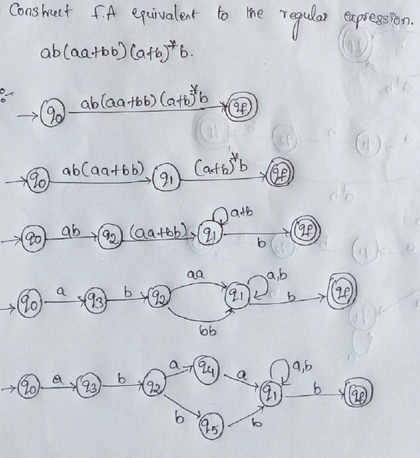

Slide 15
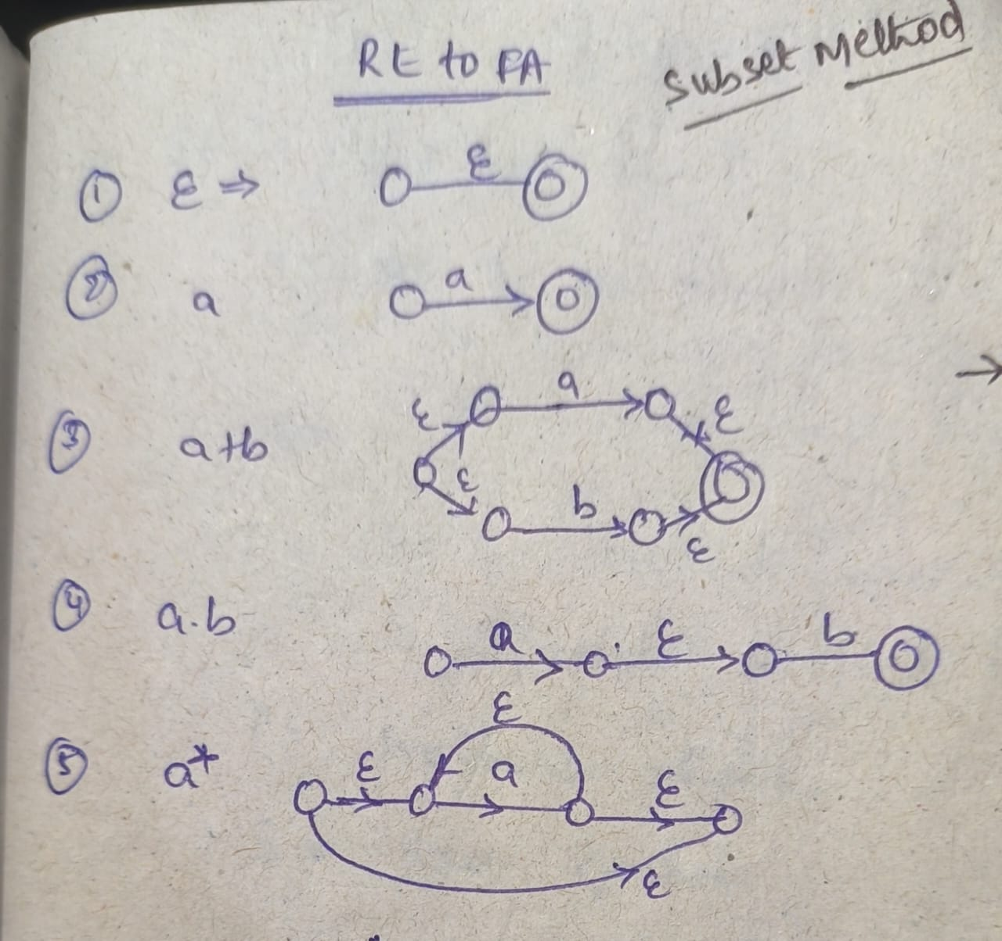
Construction FA for given RE Using Subset Method
To convert the regular expression (RE) to Finite Automata (FA), we can use the Subset method.
Subset method is used to obtain FA from the given RE.
Step 1 − Construct a Transition diagram for a given RE by using Non-deterministic finite automata (NFA) with ε moves.
Step 2 − Convert NFA with ε to NFA without ε.
Step 3 − Convert the NFA to the equivalent Deterministic Finite Automata (DFA).

Slide 16
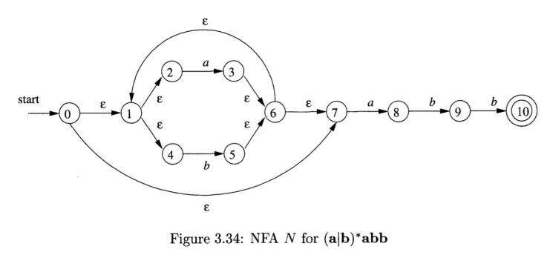
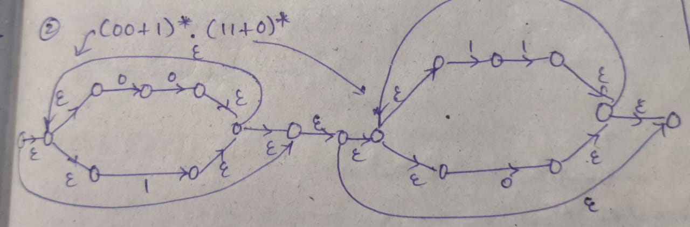
Examples
Step 1:
Find out next two steps
Step 2 − Convert NFA with ε to NFA without ε.
Step 3 − Convert the NFA to the equivalent Deterministic Finite Automata (DFA).
Step 1:

Slide 17
Conversion of FA to RE
Arden's Theorem:
In order to find out a regular expression of a Finite Automaton, we use Arden’s Theorem along with the properties of regular expressions.
Statement :
Let P and Q be two regular expressions.
If P does not contain null string, then R = Q + RP has a unique solution that is R = QP*
Proof :
R = Q + (Q + RP)P [After putting the value R = Q + RP]
= Q + QP + RPP
When we put the value of R recursively again and again, we get the following equation
R = Q + QP + QP² + QP³…..
R = Q (ε + P + P² + P³ + …. )
R = QP* [As P* represents (ε + P + P2 + P3 + ….) ]
Hence, proved.

Slide 18
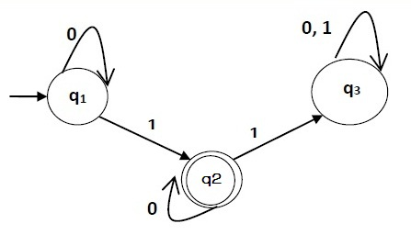
Construct a regular expression corresponding to the automata given below
Solution −
Here the initial state is q₁ and the final state is q₂
Now we write down the equations
q₁ = q₁0 + ε
q₂ = q₁1 + q₂0
q₃ = q₂1 + q₃0 + q₃1
Now, we will solve these three equations
q₁ = ε0* [As, εR = R]
So, q₁ = 0*
q₂ = 0*1 + q₂0
So, q₂ = 0*1(0)* [By Arden’s theorem]
Hence, the regular expression is 0*10*.

Slide 19
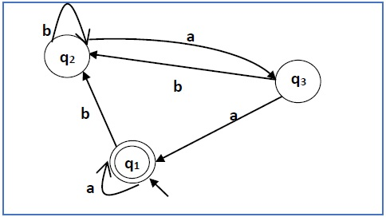
Construct a regular expression corresponding to the automata given below
Solution :
Here the initial state is q₁ and the final state is q₁.
The equations for the three states q1, q2, and q3 are as follows
q₁ = q₁a + q₃a + ε (ε move is because q1 is the initial state)
q₂ = q₁b + q₂b + q₃b
q₃ = q₂a
Now, we will solve these three equations
q₂ = q₁b + q₂b + q₃b
= q₁b + q₂b + (q₂a)b (Substituting value of q₃)
= q₁b + q₂(b + ab)
= q₁b (b + ab)* (Applying Arden’s Theorem)
q₁ = q₁a + q₃a + ε
= q₁a + q₂aa + ε (Substituting value of q₃)
= q₁a + q₁b(b + ab*)aa + ε (Substituting value of q₂)
= q₁(a + b(b + ab)*aa) + ε
= ε (a+ b(b + ab)*aa)*
= (a + b(b + ab)*aa)*
Hence, the regular expression is (a + b(b + ab)*aa)*.

Slide 20
Regular sets & Properties of Regular sets
Any set that represents the value of the Regular Expression is called a Regular Set.
Properties of Regular Sets:
Property 1. The union of two regular set is regular.
Proof :
Let us take two regular expressions RE₁ = a(aa)* and RE₂ = (aa)*
So, L₁ = {a, aaa, aaaaa,.....} (Strings of odd length excluding Null) and L₂ ={ ε, aa, aaaa, aaaaaa,.......} (Strings of even length including
Null)
L₁ 𝖴 L₂ = { ε, a, aa, aaa, aaaa, aaaaa, aaaaaa,.......}
(Strings of all possible lengths including Null)
RE (L₁ 𝖴 L₂) = a* (which is a regular expression itself) Hence, proved.

Slide 21
Property 2. The intersection of two regular set is regular.
Proof:
Let us take two regular expressions RE₁ = a(a*) and RE₂ = (aa)*
So, L₁ = { a,aa, aaa, aaaa, ....} (Strings of all possible lengths
excluding Null)
L₂ = { ε, aa, aaaa, aaaaaa,.......} (Strings of even length including Null) L₁ ∩ L₂ = { aa, aaaa, aaaaaa,.......} (Strings of even length excluding Null)
RE (L₁ ∩ L₂) = aa(aa)* which is a regular expression itself.
Hence, proved.

Slide 22
Property 3. The complement of a regular set is regular.
Proof :
Let us take a regular expression
RE = (aa)*
So, L = {ε, aa, aaaa, aaaaaa, .......} (Strings of even length including
Null)
Complement of L is all the strings that is not in L.
So, L’ = {a, aaa, aaaaa, .....} (Strings of odd length excluding Null) RE (L’) = a(aa)* which is a regular expression itself.
Hence, proved.

Slide 23
Property 4. The difference of two regular set is regular.
Proof :
Let us take two regular expressions RE₁ = a (a*) and RE₂ = (aa)*
So, L₁ = {a, aa, aaa, aaaa, ....} (Strings of all possible lengths excluding
Null)
L₂ = { ε, aa, aaaa, aaaaaa,.......} (Strings of even length including Null) L₁ – L₂ = {a, aaa, aaaaa, aaaaaaa, ....}
(Strings of all odd lengths excluding Null)
RE (L₁ – L₂) = a (aa)* which is a regular expression.
Hence, proved.

Slide 24
Property 5. The reversal of a regular set is regular.
Proof
We have to prove L^{R} is also regular if L is a regular set. Let, L = {01, 10, 11, 10}
RE (L) = 01 + 10 + 11 + 10
L^{R} = {10, 01, 11, 01}
RE (L^{R}) = 01 + 10 + 11 + 10 which is regular
Hence, proved.
Property 6. The closure of a regular set is regular.
Proof
If L = {a, aaa, aaaaa, .......} (Strings of odd length excluding Null) i.e., RE (L) = a (aa)*
L* = {a, aa, aaa, aaaa , aaaaa,……………} (Strings of all lengths
excluding Null)
RE (L*) = a (a)* Hence, proved.

Slide 25
Property 7. The concatenation of two regular sets is regular.
Proof
Let RE₁ = (0+1)*0 and RE₂ = 01(0+1)*
Here, L₁ = {0, 00, 10, 000, 010, ......} (Set of strings ending in 0) and L₂ = {01, 010,011,.....} (Set of strings beginning with 01) Then, L₁ L₂ =
{001,0010,0011,0001,00010,00011,1001,10010,.............}
Set of strings containing 001 as a substring which can be represented by an RE − (0 + 1)*001(0 + 1)*
Hence, proved.

Slide 26
Context Free Grammar(CFG)
Definition : A context-free grammar (CFG) consisting of a finite set of grammar rules is a quadruple (V, T, P, S) where
V is a set of non-terminal symbols./ Variables
Represented in uppercase
T is a set of terminals where N ∩ T = NULL./Symbols
Represented in lowercase
P is a set of rules, P: N → (N ∪ T)*, i.e., the left-hand side of the production rule P does have any right context or left context.
S is the start symbol.
Example
The grammar ({A}, {a, b, c}, P, A), P : A → aA, A → abc.
The grammar ({S}, {a, b}, P, S), P: S → aSa, S → bSb, S → ε
The grammar ({S, F}, {0, 1}, P, S), P: S → 00S | 11F, F → 00F | ε

Slide 27
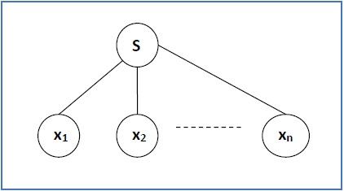
Derivation Tree/Parse Tree
A derivation tree or parse tree is an ordered rooted tree that graphically represents the semantic information a string derived from a context-free grammar.
Representation Technique:
Root vertex − Must be labeled by the start symbol.
Vertex/Intermediate Node − Labeled by a non-terminal symbol.
Leaves − Labeled by a terminal symbol or ε.
If S → x₁x₂ …… x_{n} is a production rule in a CFG, then the parse tree / derivation tree will be as follows
There are two different approaches to draw a derivation tree
Top-down Approach
Starts with the starting symbol S
Goes down to tree leaves using productions
Bottom-up Approach
Starts from tree leaves
Proceeds upward to the root which is the starting symbol S

Slide 28
Derivation Tree/Parse Tree
Derivation or Yield of a Tree
The derivation or the yield of a parse tree is the final string obtained by concatenating the labels of the leaves of the tree from left to right, ignoring the Nulls. However, if all the leaves are Null, derivation is Null.
Example
Let a CFG {N,T,P,S} be
N = {S}, T = {a, b}, Starting symbol = S, P = S → SS | aSb | ε
One derivation from the above CFG is “abaabb”
S → SS
→ aSbS
→ abS
→ abaSb
→ abaaSbb
→ abaabb

Slide 29
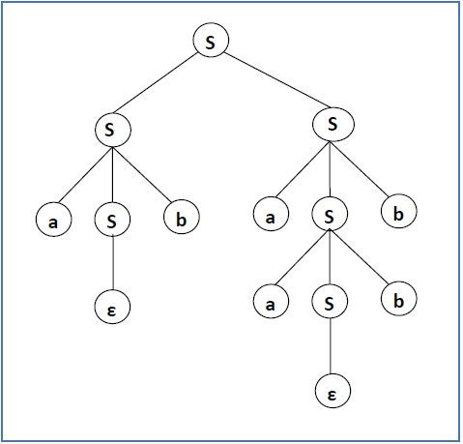
Generation of Derivation Tree:

Slide 30
Leftmost and Rightmost Derivation of a String
Leftmost derivation: A leftmost derivation is obtained by applying production to the leftmost variable in each step.
Rightmost derivation: A rightmost derivation is obtained by applying production to the rightmost variable in each step.
Leftmost Derivation: Example
Let any set of production rules in a CFG be
X → X+X | X*X |X| a
over an alphabet {a}.
The leftmost derivation for the string "a+a*a" may be
X → X+X
→ a+X
→ a + X*X
→ a+a*X
→ a+a*a

Slide 31
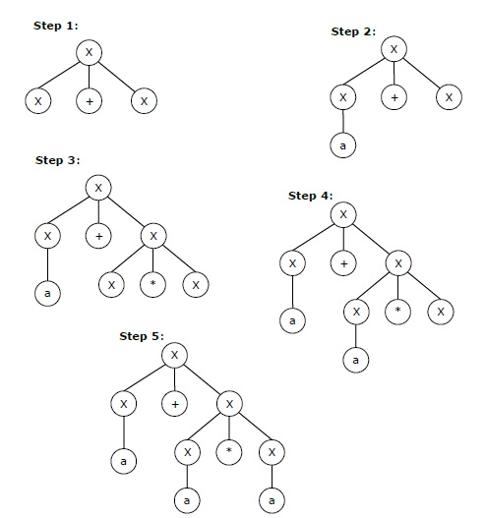
Leftmost Derivation Tree of a String
The stepwise derivation of the above string is shown as below

Slide 32
Rightmost Derivation of a String
Let any set of production rules in a CFG be
X → X+X | X*X |X| a
over an alphabet {a}.
The rightmost derivation for the above string "a+a*a" may be
X → X*X
→ X*a
→ X+X*a
→ X+a*a
→ a+a*a

Slide 33
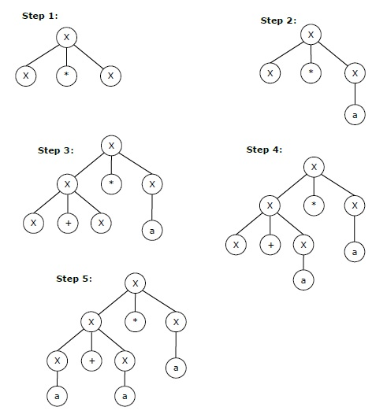
Rightmost Derivation Tree of a String
The stepwise derivation of the above string is shown as below

Slide 34
Ambiguity in context free grammar
If a context free grammar G has more than one derivation tree for some string w ∈ L(G), it is called an ambiguous grammar. There exist multiple right-most or left-most derivations for some string generated from that grammar.
Problem:
Check whether the grammar G with production rules
X → X+X | X*X |X| a is ambiguous or not.
Solution:
Let’s find out the derivation tree for the string "a+a*a". It has two leftmost derivations.
Derivation 1 − X → X+X
→ a +X
→ a+ X*X
→ a+a*X
→ a+a*a

Slide 35
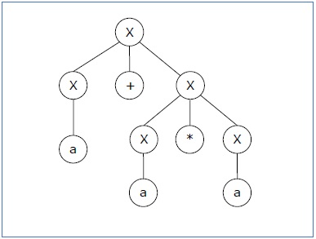
Ambiguity in context free grammar
Parse tree 1:

Slide 36
Ambiguity in context free grammar
Derivation 2
X → X*X
→ X+X*X
→ a+ X*X
→ a+a*X
→ a+a*a

Slide 37
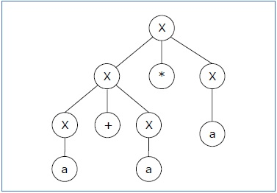
Ambiguity in context free grammar
Parse tree 2
Since there are two parse trees for a single string "a+a*a", the grammar G is ambiguous.

Slide 38
Minimization of Context free grammar
In a CFG, it is not necessary to use all the symbols in V or all the productions in P for driving sentences. We get the simplified grammar by the following methods:
Eliminating useless symbols
Elimination of unit productions
Removal of ∈ productions or nullable non-terminals.

Slide 39
Eliminating useless symbols
A Variable which is not involved in derivation of any string
A Variable that can’t be reached from start symbol of grammar
If a Variable is reachable from start symbol but does not derive any terminal
Remove useless symbols to reduce CFG
Eliminate the useless symbols for the given CFG,
S → aB/ bX
A → BAd/ bSX/ a
B → asB/ bBX
X → SBD/ aBX/ ad
Solution:
Here, A and X are useful as they derive a and ad as A → a and X → ad. Also, S → bX and S ⇒ bad, so S is also useful and generating. But B doesn’t derive anything, so it is a useless symbol. So, we eliminate those productions that consist of B.

Slide 40
Eliminating useless symbols
Then, the grammar becomes,
S → bX
A → bSX/ a
X → ad
Again, we see that A cannot be reached from the starting non-terminal S, so we eliminate the productions consisting of A. Then, we get,
S → bX
X → ad
This is the required grammar.

Slide 41
Elimination of unit productions
If any production is in the form A→B, then it is called unit production.
To eliminate unit productions, use following rule
If a production is in the form A→B and B→ x1,x2,….xn then write the productions as A→ x1,x2,….xn
Example:
Eliminate the unit productions for the given CFG,
S → A/ bb
A → B/ b
B → S/ a
Solution:
We have, S → A
A → B
B → S are the three unit productions.

Slide 42
Elimination of unit productions
We can eliminate these unit productions as follows,
S → A generates S → b
S → A → B generates S → a
A → B generates A → a
A → B → S generates A → bb
B → S generates B → bb
B→ S → A generates B → b
Then, the reduced grammar is,
S → bb/ b/ a
This is the required grammar.

Slide 43
Removal of ∈ productions
Remove ∈ symbols to reduce CFG
Eliminate the ∈ productions for the given CFG,
S → aA
A → b/ ∈
Solution:
We have, S → aA
A → b/ ∈
Here, as A → ∈ is clearly an empty production, we eliminate the ∈ productions as follows,
S → aA/ a
A → b
This is the required CFG.

Slide 44
Chomsky Normal Form(CNF)
The given CFG is known as CNF if it is in CNF it follows:
If the start symbol can have ∈-production then that production is in the form of CNF.
Ex: S → ∈
If the non terminal generating single terminal them it is in form of CNF
Ex: A → a this is in form of CNF
A → ab this is not in form of CNF
If the non terminal generating two non terminals them it is in form of CNF
Ex:- A → BC this is in form of CNF
A → BCD this is not in form of CNF
A → aB this is not in form of CNF

Slide 45
Converting CFG into Chomsky Normal Form
Step 1: If the start symbol S it occurs on some right side, create a new start symbol S1 and a new production S1→ S.
Ex:- S → ASB
S1 → S
S → ASB
Step 2: Remove Null productions. (Using the Null production removal algorithm discussed earlier)
Step 3: If the right side of any production is in the form
A → aB where a is a terminal and A, B are non-terminal, then the production is replaced by A → XB and X → a. Repeat this step for every production which is in the form A → aB.
Step 4: Replace each production A → B₁…B_{n} where n > 2
Reduce the number of non terminals on right hand side by creating new production
Ex:- S → ABC
S → XC
X → AB

Slide 46
Problem
Convert the following CFG into CNF
S → ASB | aB
A → B | S
B → b | ε
Solution
(Step 1) Since S appears in R.H.S, we add a new state S₀ and S₀→S is added to the production set and it becomes
S₀→S
S→ ASB | aB
A → B | S
B → b | ∈
(Step 2) Now we will remove the null productions
B → ∈ and A → ∈
After removing B → ε, the production set becomes
S₀→S
S→ ASB | aB | AS | a
A → B | S | ∈
B → b
After removing A → ∈, the production set becomes
S₀→S
S→ ASB | aB | AS | a |SB | S
A → B | S
B → b

Slide 47
(Step 2) Now we will remove the unit productions.
After removing S → S, the production set becomes
S₀→S
S→ ASB | aB | AS | a |SB
A → B | S
B → b
After removing S₀→ S, the production set becomes
S₀→ ASB | aB | AS | a |SB
S→ ASB | aB | AS | a |SB
A → B | S
B → b
After removing A→ B, the production set becomes
S₀ → ASB | aB | AS | a |SB
S→ ASB | aB | AS | a |SB
A → B | S
B → b
After removing A→ S, the production set becomes
S₀ → ASB | aB | AS | a |SB
S→ ASB | aB | AS | a |SB
A → b | ASB | aB | AS | a |SB
B → b

Slide 48
(Step 3) Now replace terminal with non terminals
S₀ → ASB | XB | AS | a |SB
S→ ASB | XB | AS | a |SB
A → b | ASB | XB | AS | a |SB
B → b
X → a
(Step 4) Now we will find out more than two variables in the R.H.S
Here,
S₀ → YB | XB | AS | a |SB
S→ YB | XB | AS | a |SB
A → b | YB | XB | AS | a |SB
B → b
X → a
Y → AS
The above production rules are in the form of CNF

Slide 49
Recursion
Recursion: a function which is calling by itself is called recursion.
It has two types
Left recursion
Right recursion
Left recursion: if the production rule is in the form A → A α| β then this grammar contain left recursion.
Here problem with left recursion is A → is calling A only it doesn’t go to α, then α doesn’t executing
It is not suitable for Top down parsing then we have to remove left recursion
Right recursion: if the production rule is in the form A → αA| β then this grammar contain left recursion.

Slide 50
Left Recursion
Removal of left recursion:
To eliminate direct left recursion replace
A → A α| β
Replace with A → βA’
A’ → αA’| ε
In generalized form
A → Aα₁ | Aα₂ | ... | Aα_{m} | β₁ | β₂ | ... | β_{n}
with
A → β₁A’ | β₂A’ | ... | β_{n}A’
A’ → α₁A’ | α₂A’ | ... | α_{m}A’ | ε

Slide 51
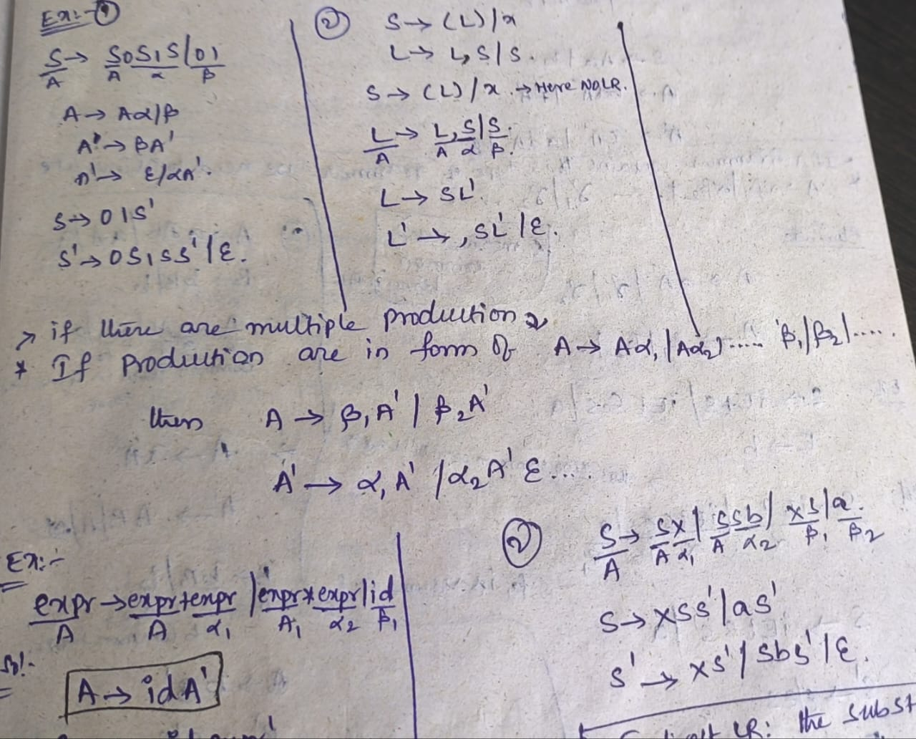
Examples

Slide 52
Example
Consider the left recursive grammar
E → E + T | T
T → T * F | F
F → (E) | id
Apply the transformation to E:
E → T E'
E' → + T E' | ε.
Then apply the transformation to T:
T → F T'
T' → * F T' | ε.

Slide 53
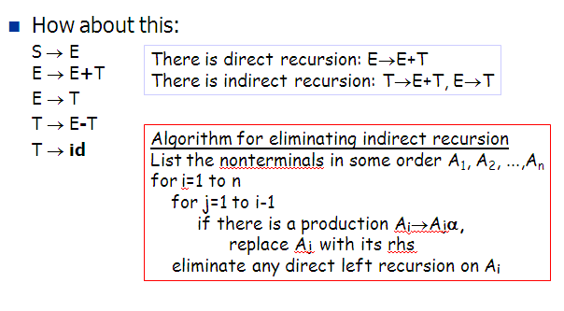
Elimination of Left Recursion cond..

Slide 54
Elimination of Indirect Left Recursion
ordering: S, E, T, F
i=S
i=E
i=T, j=E
S → E E → E+T
E → T
T → E-T
T → F
F → E*F
F → id
S → E E → E+T
E → T
T → E-T
T → F
F → E*F
F → id
S → E E → TE'
E'→+TE'|ε
T → E-T
T → F
F → E*F
F → id
S → E E → TE'
E'→+TE'|ε
T → TE'-T
T → F
F → E*F
F → id
S → E E → TE'
E'→+TE'|ε
T → FT'
T' → E'-TT'|ε
F → E*F
F → id

Slide 55
Elimination of Indirect Left Recursion
i=F, j=E
i=F, j=T
S → E E → TE'
E'→+TE'|ε
T → FT'
T' → E'-TT'|ε
F → TE'*F
F → id
S → E E → TE'
E'→+TE'|ε
T → FT'
T' → E'-TT'|ε
F → FT'E'*F
F → id
S → E E → TE'
E'→+TE'|ε
T → FT'
T' → E'-TT'|ε
F → idF'
F' → T'E'*FF'|ε

Slide 56
Greibach Normal Form(GNF)
The given CFG is known as GNF if it is in GNF it follows:
Start symbol can generate ε
Ex:- S→ ε
If non terminal generating single terminal then this is in the form of GNF
Ex:- S→ a
If non terminal generating terminal followed by any number of terminals or non terminals then this is in the form of GNF
Ex:- S→ aBbCc

Slide 57
Greibach Normal Form(GNF)
Steps to convert CFG to GNF:-
1. If the given grammar is not in CNF, convert it to CNF.
2. Change the names of the non terminals in some ascending order.
Ex:- S→ AB
S with A1 and A with A2, B with A3
After rename productions are
A1→ A2 A3
3. For each production check following rules
If i<j don’t change the production.
If i>j replace Aj with it productions.
If i==j eliminate the left recursion.
4. Remove left recursion
5. Make the productions following GNF Rules.

Slide 58
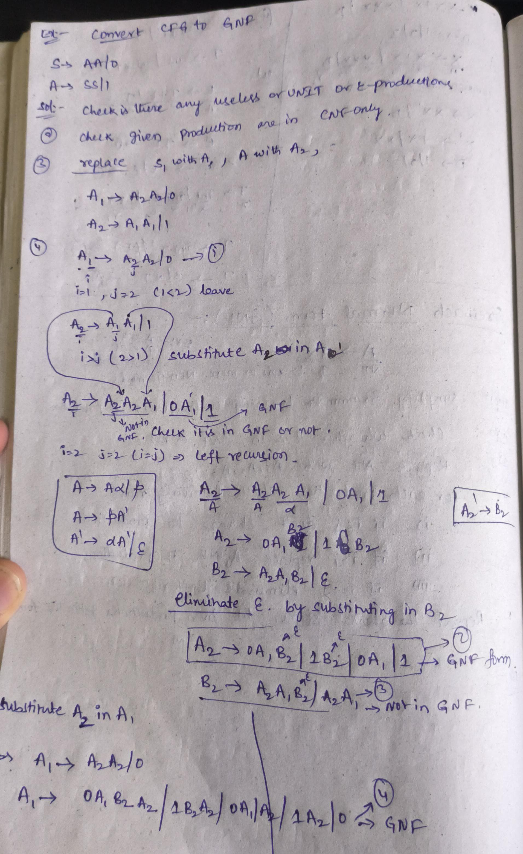
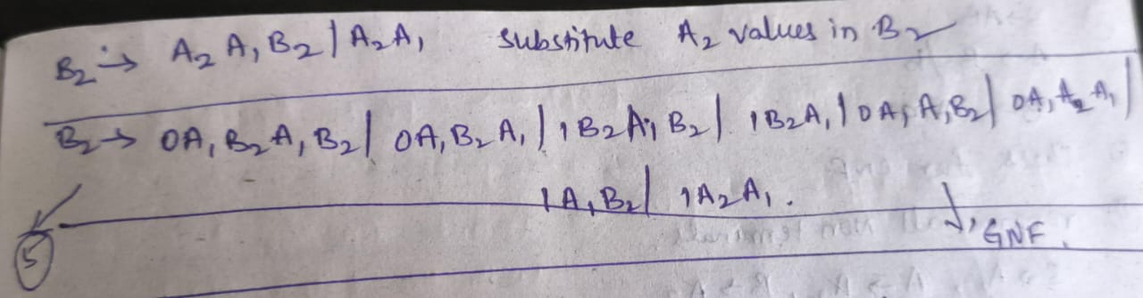
Final Productions are
A1 → 0A1B2A2 / 1B2A2 /0A1 / 1A2 / 0
A2 → 0A1B2 / 1B2 /0A1 /1
B2 → 0A1B2A1B2 / 0A1B2A1 /1B2A1B2 / 1B2A1/ 0A1A1B2 / 0A1A2A1 /1A1B2 /1A2A1
Above all production are in GNF

Slide 59
Example
S → XA|BB B → b|SB X → b A → a
For converting a CNF to GNF first rename the non terminal symbols to A₁,A₂ till A_{N} in same sequence as they are used.
A₁ = S A₂ = X A₃ = A A₄ = B
Therefore, now the new production rule is,
A₁ → A₂A₃ | A₄A₄ A₂ → b A₃ → a A₄ → b | A₁A₄

Slide 60
Now, check for every production A_{i} → A_{j} X, where X can be any number of terminal symbols. If i<j in the production then it is good to go to the next step but if i>=j then change the production by replacing it with that terminal symbol’s production. if i=j then it is a left recursion and you need to remove left recursion.
Here for A₄, 4 !< 1, so now replace it with A₁‘s production rule.
1. A₁ → A₂A₃ | A₄A₄ A₂ → b A₃ → a A₄ → b | A₂A₃A₄ | A₄A₄A₄ ---------------------- 2. A₁ → A₂A₃ | A₄A₄ A₂ → b A₃ → a A₄ → b | bA₃A₄ | A₄A₄A₄

Slide 61
Here A₄A₄A₄ in production rule of A₄ is the example of left recursion.
To replace the left most recursion take a new Non terminal symbol Z, which has the X part or the trailing part of the left most recursive production once followed by Z and once without Z. Here in A₄A₄A₄, the part after the first A₄ is A₄A₄, therefore
Z → A₄A₄ | A₄A₄ZNow change the above production rule by putting Z after every previous production of that A_{i}, and remove the left recursive production.
A₁ → A₂A₃ | A₄A₄ A₂ → b A₃ → a A₄ → b | bA₃A₄ | bZ | bA₃A₄Z Z → A₄A₄ | A₄A₄ZThe Last step is to replace the production to the form of either
A_{i} → x (any single terminal symbol)
OR
A_{i} → xX (any single terminal followed by any number of non terminals)
So here we need to replace A₂ in production rule of A₁ and so on.
A₁ → bA₃ | bA₄ | bA₃A₄A₄ | bZA₄ | bA₃A₄ZA₄ A₂ → b A₃ → a A₄ → b | bA₃A₄ | bZ | bA₃A₄Z Z → bA₄ | bA₃A₄A₄ | bZA₄ | bA₃A₄ZA₄ | bA₄Z | bA₃A₄A₄Z | bZA₄Z | bA₃A₄ZA₄ZThe respective grammar is non in GNF form.

Slide 62
Example 2
Problem
Convert the following CFG into CNF
S → XA|BB
B → b|SB
X → b
A → a
As G1 is already in CNF and there is not left recursion, we can skip step 1and 2 and directly move to step 3. The production rule B->SB is not in GNF, therefore, we substitute S -> XA|BB in production rule B->SB as:
S → XA|BB
B → b|XAB|BBB
X → b
A → a
The production rules S->XA and B->XAB is not in GNF, therefore, we substitute X->b in production rules S->XA and B->XAB as:
S → bA|BB
B → b|bAB|BBB
X → b
A → a

Slide 63
Greiback normal form
Removing left recursion (B->BBB), we get:
S → bA|BB
B → bC|bABC
C → BBC| ε
X → b
A → a
Removing null production (C-> ε), we get:
S → bA|BB
B → bC|bABC|b|bAB
C → BBC|BB
X → b
A → a

Slide 64
Greiback normal form
The production rules S->BB is not in GNF, therefore, we substitute B → bC|bABC|b|bAB in production rules S->BB as:
S → bA| bCB|bABCB|bB|bABB
B → bC|bABC|b|bAB
C → BBC|BB
X → b
A → a
The production rules C->BB is not in GNF, therefore, we substitute B → bC|bABC|b|bAB in production rules C->BB as:

Slide 65
Greiback normal form
S → bA| bCB|bABCB|bB|bABB
B → bC|bABC|b|bAB
C → BBC
C → bCB|bABCB|bB|bABB
X → b
A → a
The production rules C->BBC is not in GNF, therefore, we substitute B → bC|bABC|b|bAB in production rules C->BBC as:
S → bA| bCB|bABCB|bB|bABB
B → bC|bABC|b|bAB
C → bCBC|bABCBC|bBC|bABBC
C → bCB|bABCB|bB|bABB
X → b
A → a
This is the GNF form for the grammar G1.

